Slide 1
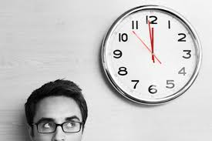
Unit 2: In Search of Time
IELTS Demo Class
Chris R. Mitchell
July 9th

Slide 2
A Quick Intro:
Please participate
If you don’t, who will?
You learn more from failure than you do from success
What do you have to lose?
I promise, I won’t kick you out
I don’t bite (hard)

Slide 3
Today’s focus:
Listening
Section 2 (predictions)
Vocabulary Expansion
Collocations
Synonyms
Adjectives
Writing
Task 2 (proper introduction)
Speaking
Part 1, 2, and 3
Reading
Pre-reading, keyword focus reading (scanning vs skimming)

Slide 4
breakfast | go | save | a decision
your homework | energy | do | put
water | on vacation | a bath | drink
make | take | away | eat
get | in trouble | dressed | medicine

Slide 5
Collocations
What are collocations?
Two or more words that appear together at a higher frequency than others
“Let’s have a meal”
“We will take an exam”
“If you make a mistake…”

Slide 6
Verb + noun(time) collocations
When does time drag?
What do serious students ____ a lot of their time doing?
What kind of gadgets do people use to ______time on trains?
How can people _____ a good time in your city?
Why do computer _____time?
When does time _____?
save
spend
kill
take
drag
have
fly

Slide 7
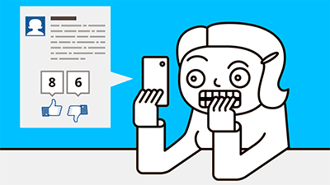
Collocations in Speaking Part 1
Sentence stress
Nouns + Verbs = Stressed
Grammar words (a, an, in, at, do) NOT stressed
Example: What’s your name?

Slide 8
Your Turn!
What are you studying?
Describe how people spend their free time in your home country.
Do young people have the same leisure activities now as in the past?
How do you spend your free time?

Slide 9
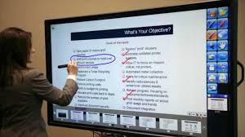
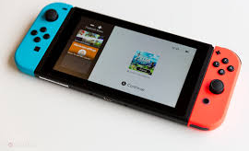
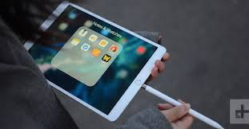
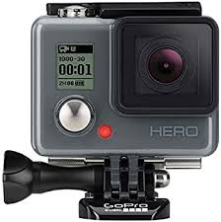
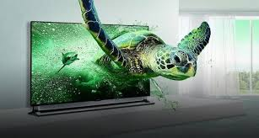
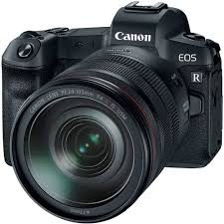
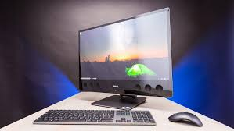

Slide 10
The _____ is very useful. It is smaller than a laptop and you can use it to read books as well as surf the net.
Watching the latest _____ is very enjoyable because they bring the image to life.
_____ are very interesting as you can play thm anywhere in your leisure time.
The _____ is an invaluable piece of equipment. It can save teachers a lot of time and energy
The _____ is an efficient device because it means you produce photos and videos quickly.
Some people think _____ can be dangerous as they can cause
Electronic whiteboard
3D tv
computer
Digital camera
ipad
Electronic game

Slide 11
The ipad is very useful. It is smaller than a laptop and you can use it to read books as well as surf the net.
Watching the latest 3D TV is very enjoyable because they bring the image to life.
Electronic games are very interesting as you can play thm anywhere in your leisure time.
The interactive whiteboard is an invaluable piece of equipment. It can save teachers a lot of time and energy
The digital camera is an efficient device because it means you produce photos and videos quickly.
Some people think computers can be dangerous as they can cause major problems.

Slide 12
Useful
Enjoyable
Interesting
Invaluable
Efficient
Dangerous
Satisfying
Practical
Harmful
Important
Effective
Fascinating
Synonyms

Slide 13
Complete the sentences
Are _____ harmful?
‘Yes/No, I (don’t) feel like they are dangerous.’
Do you think _____ are fascinating?
‘Yes, they are really interesting. They…’
Why do you think _____ are convenient?
‘I would say they are practical if you consider…’
Do you think a(n) _____ is invaluable?
‘Absolutely. It is an extremely important piece of…’

Slide 14
Speaking Part 2
Describe an electronic device that has changed your life What it is Where you first saw/acquired it When you got it And explain why it is so important to you

