Slide 1
International
Preparation Course in Business
Danielle Clephane

Slide 2
Course Structure, Programme Specification/Handbook Understanding

Slide 3
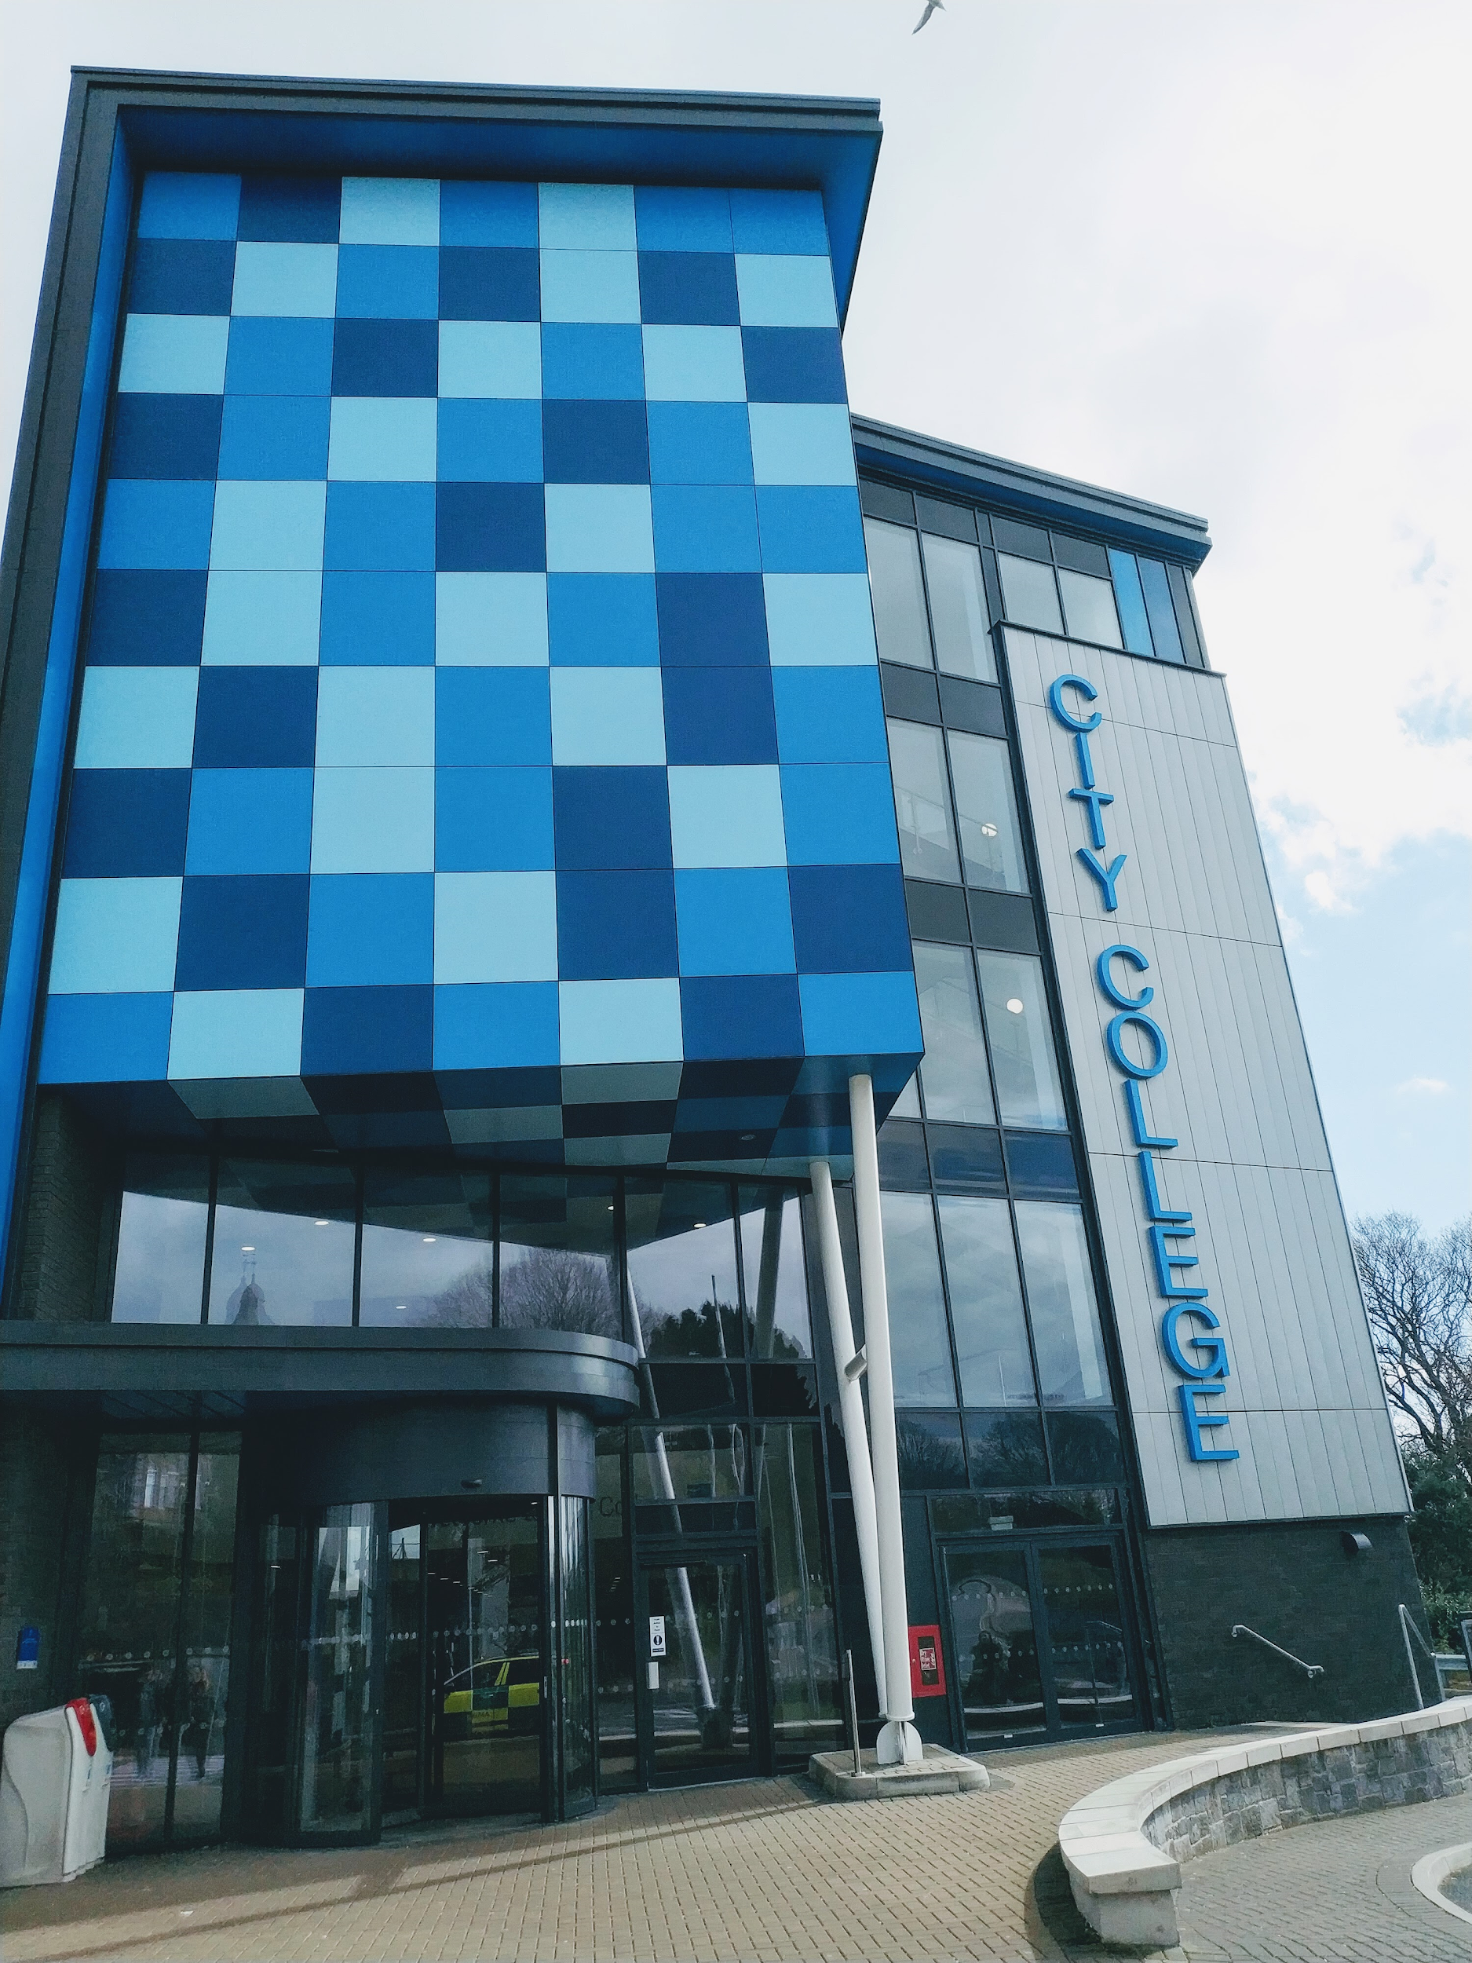
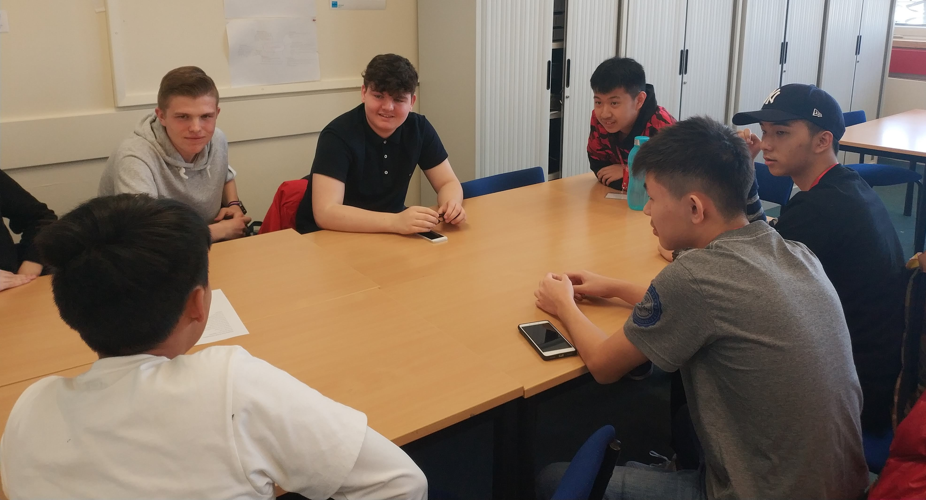
Session objectives
Gain understanding of how the handbook works and guides
teachers through each unit
Opportunity to ask questions throughout the session

Slide 4
Purpose of the IPC
On the International Preparation Course students will have the opportunity to be introduced to key aspects of business operations and analyse information, in order to make effective business decisions. This course will help their English skills and will make them feel more confident before coming to the UK to study.
Notes:
To bring new opportunities and build confidence in students surrounding studying abroad.
The course will equip students with the knowledge foundation and skills relating to the UK education system.

Slide 5
Starting point...
Level 3 equivalent
6 units
Marketing
Organisation Behaviour
Economics Environment for Business
Business Finance
Managing Knowledge & Information
English
Qualifications
2 units – Award
3 units – Certificate
4 units – Advanced Certificate
5 units – Diploma
6 units – Extended Diploma

Slide 6
Grades
Pass 40-54
Mainly based on being able to describe different elements.
Merit 55-69
Based on taking thoughts to the next level and being able to explain and analyse why businesses might do what they do for different elements.
Distinction 70-100
Taking learning to another level again of being able to justify and evaluate. Students might need to put their opinions and suggestions across but need to back up their thoughts with explanations and possibly evidence.

Slide 7
Handbook
Let’s go through the handbook...
How to use the handbook
Pick out key areas
Give hints and tips
IPC handbook

Slide 8
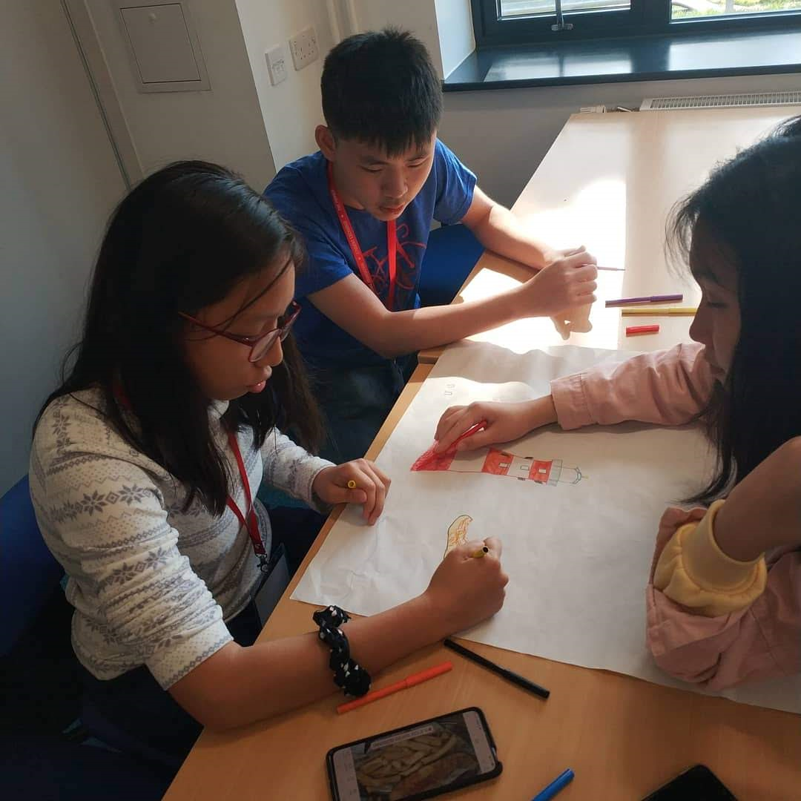
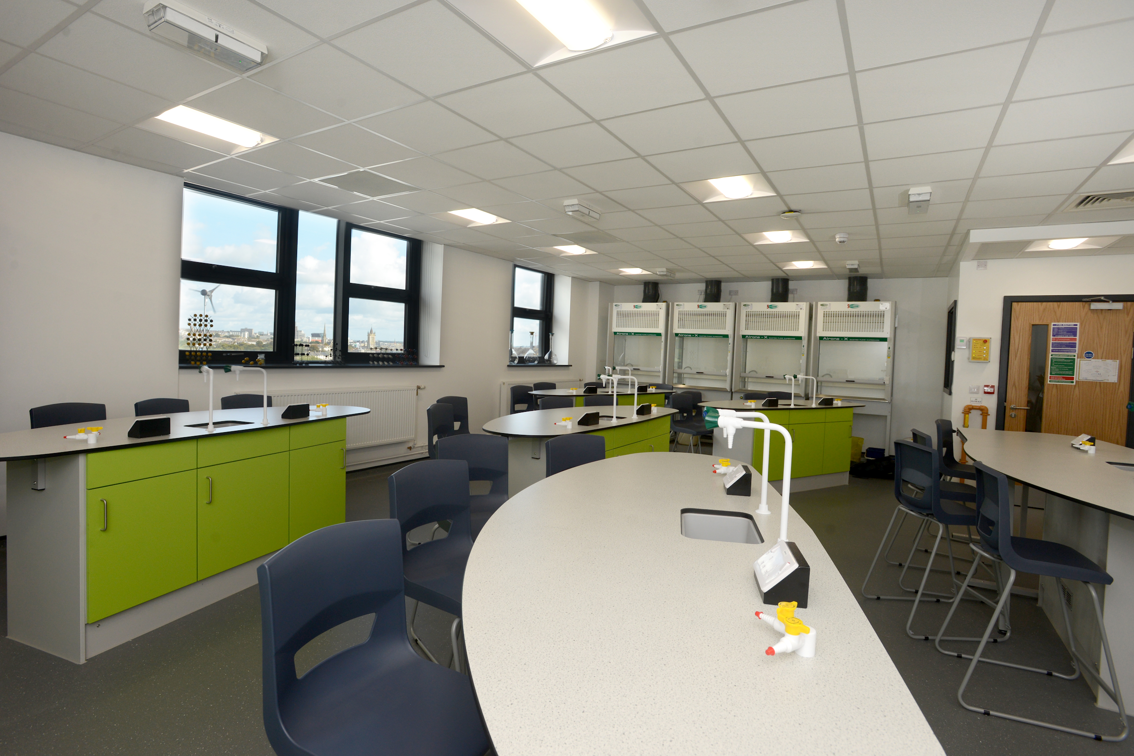
THANK YOU
ANY QUESTIONS?
I:danielle_ccp_pdvl

Slide 9
Teacher Quality
and Responsibility

Slide 10
Session Objectives
Teacher knowledge v teacher personality
Introduction on the basics of teaching in the UK
Lesson preparation

Slide 11
What is it like to be a
teacher at CCP?

Slide 12
In teaching,
how much is knowledge
and how much is teacher
personality?
Teacher
knowledge
V
Teacher Personality
Notes:
What role knowledge and personality plays. Is it equal?
Rapport / Approachability / Understanding
Overview what a lesson is like in UK

Slide 13
Basics of teaching the UK
Purpose of learning each topic
Students do most of the work
Pull information from them
Short activities/sections
Get the students involved as much as possible
Flip the classroom if required (pros and cons)
HRM lesson
Market Segmentation lesson

Slide 14
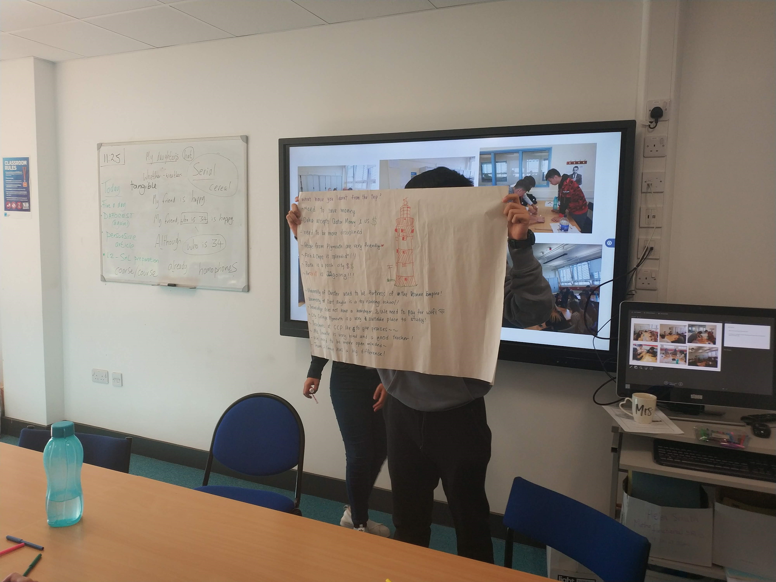

Slide 15
Lesson preparation
Scheme of work
Still need to know your topic
Key points students need to know
Base your lesson around discussion, activities and them doing the work
Recap throughout the session
Taking on the Uk education ethos

Slide 16
THANK YOU
ANY QUESTIONS?

