Slide 1
Introduction to
City College Plymouth
International Preparation Course in Business
Danielle Clephane -
International Recruitment Officer and Lecturer in Business

Slide 2
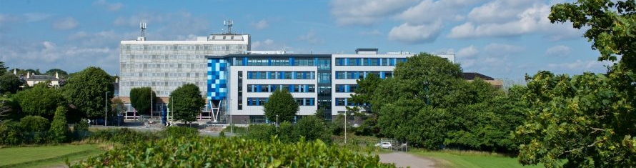
What we will discuss today
Where is Plymouth? - Senior Leadership Team
History - College environment
Facilities - Awards won
Notes:
Plymouth, UK. Please also show some videos and photos
about college, its facilities and physical building, also state the college’s history,
environment, college structures, all awards won by the college?

Slide 3
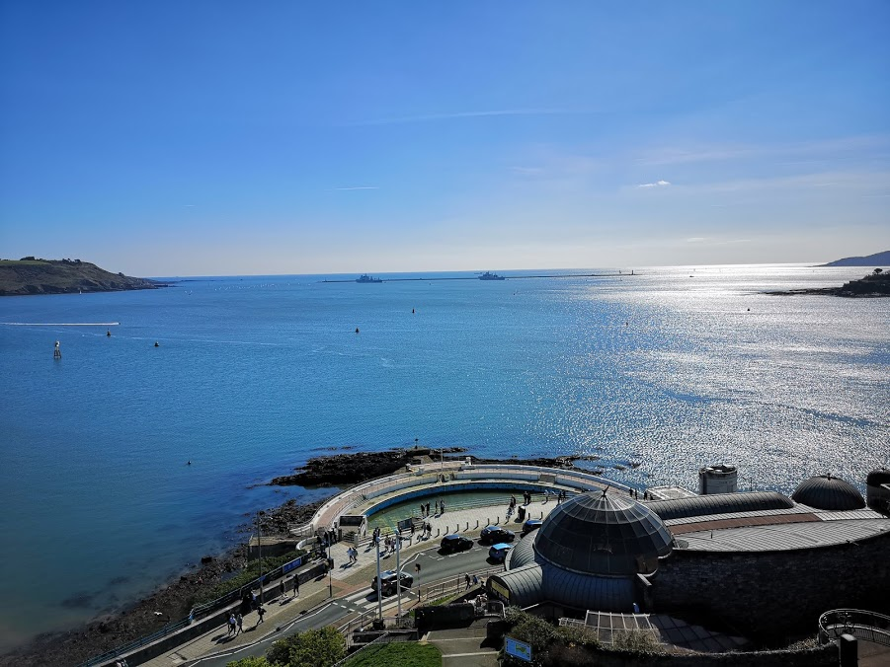
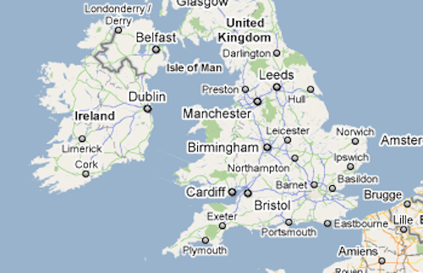
Plymouth
Most polite city
2nd safest city
Promo video of Plymouth

Slide 5
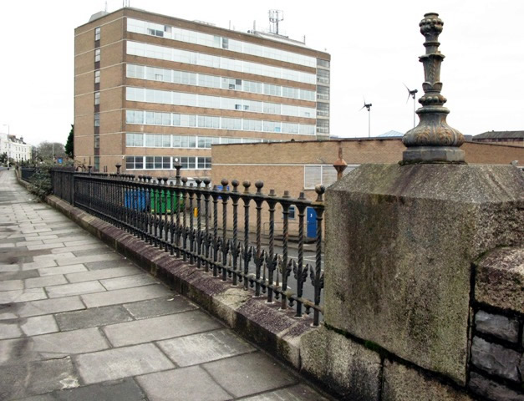
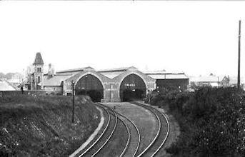
CCP
History
City College Plymouth Video

Slide 6
Facts about City College Plymouth
4 people in the Senior Leadership Team
131 years old
Government funded
Number of staff - approx 600
Number of students - approx 12,000
Range of full time and part time courses

Slide 7
Awards won

Slide 8
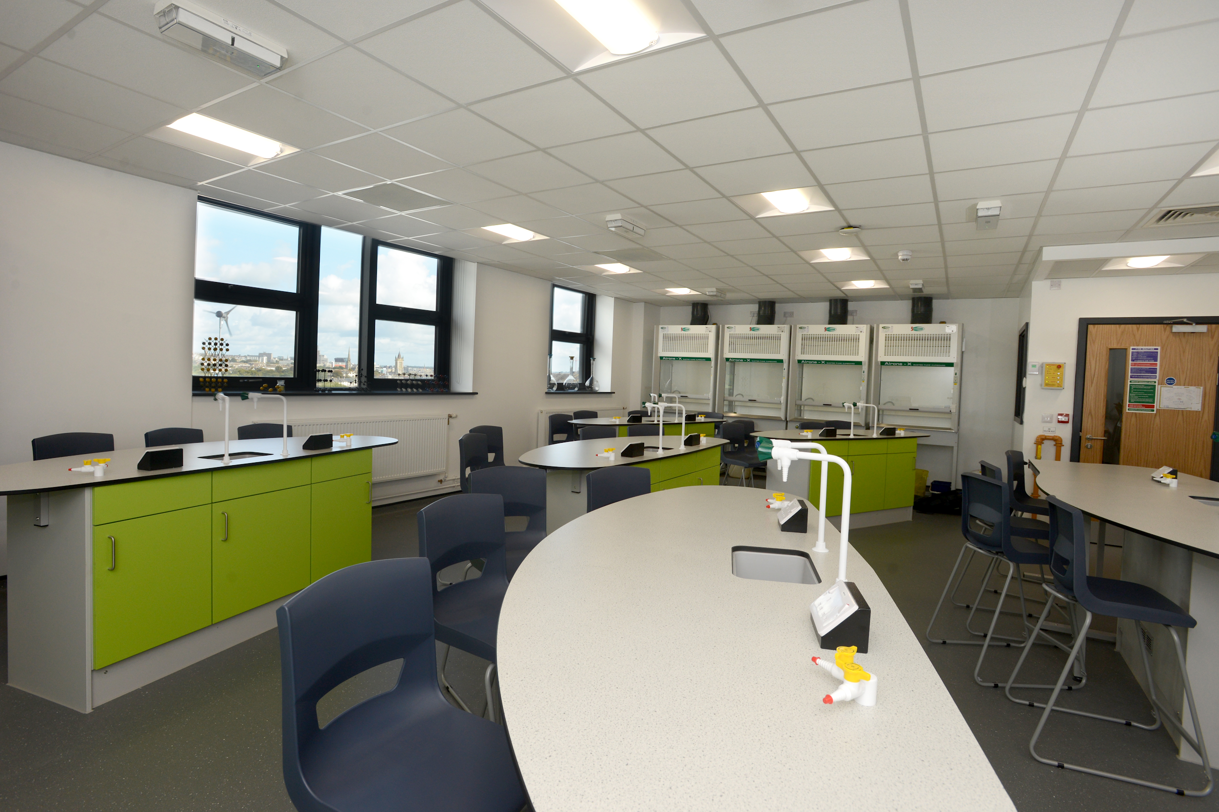
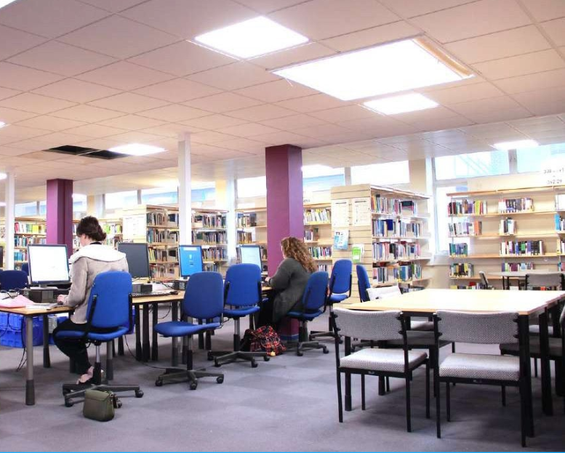
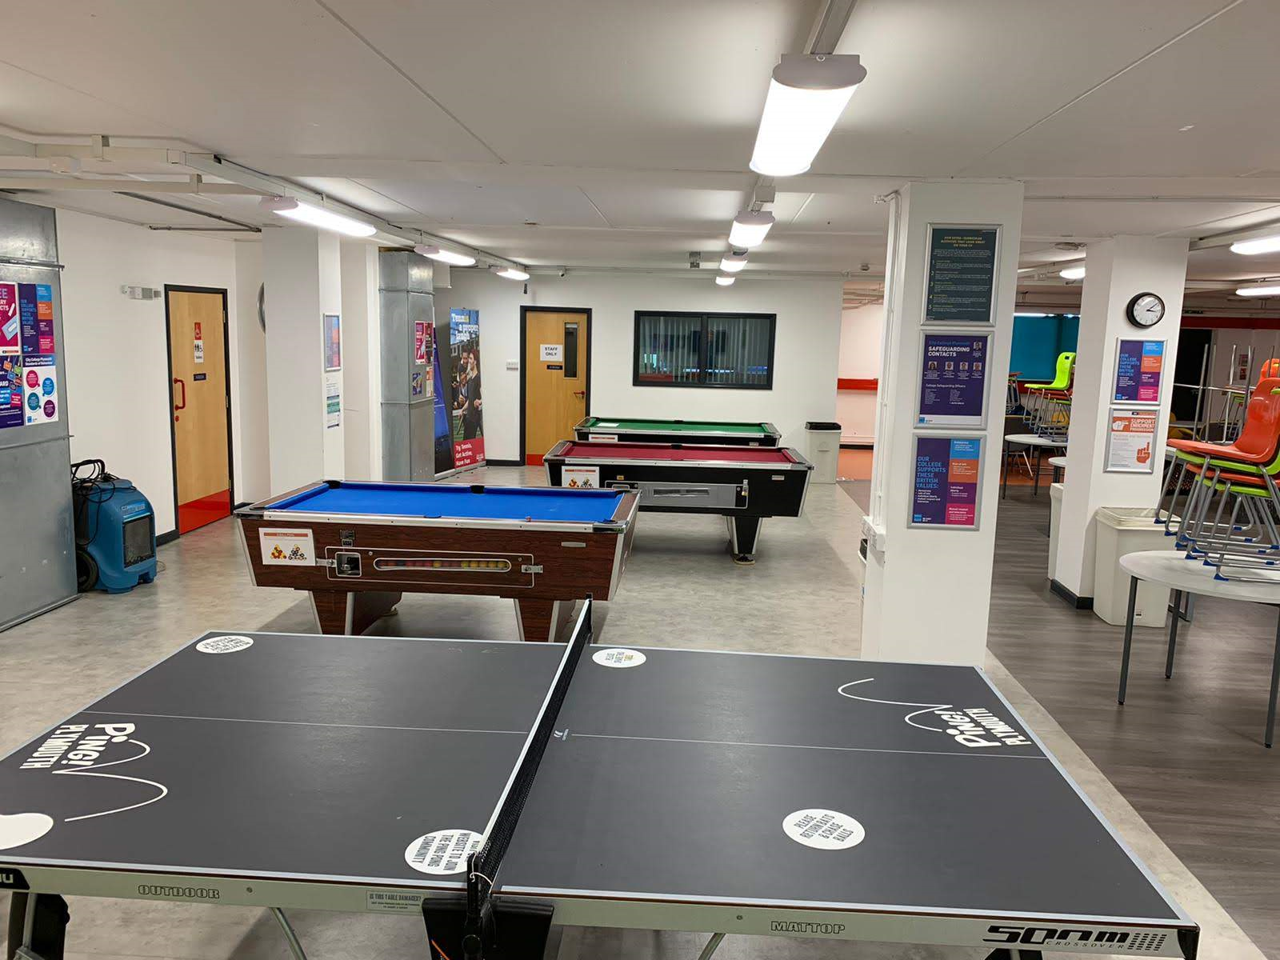
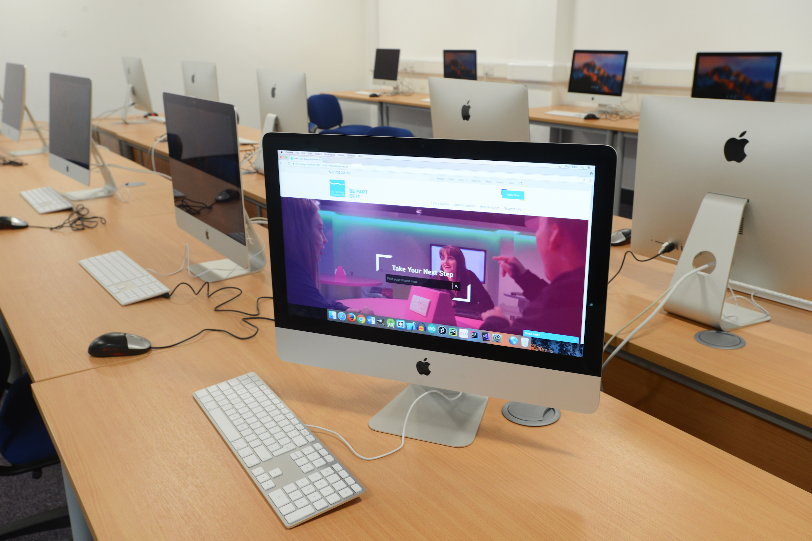
Facilities
CCP facilities video

Slide 9
Environment
Friendly
Sociable
User friendly
Inclusive - Learn from each other
Opportunities for students and staff
CCP Video

Slide 10
Thank you for
listening
Any questions?
International_ccp
danielle_ccp_pdvl

